Slide 1
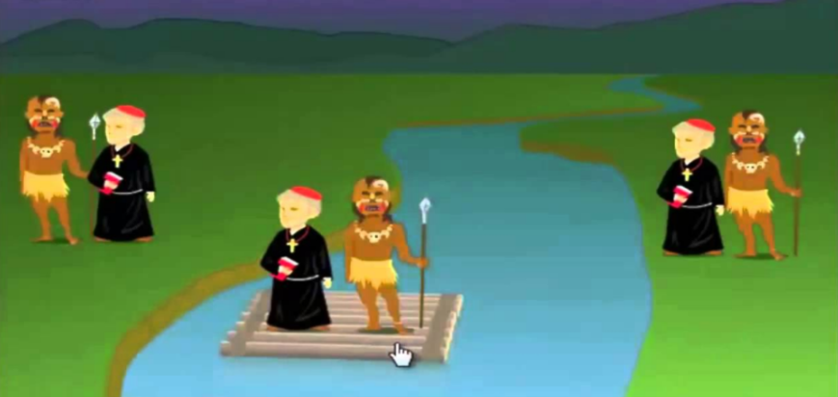
Search-Space Problem:
Missionaries and Cannibals

Slide 2
Problem Statement:
Three missionaries and three cannibals must cross a river using a boat which can carry at most two people.
Under the constraint that:
For both banks, if there are missionaries present on the bank, they cannot be outnumbered by cannibals.
If they were, the cannibals would eat the missionaries.
And the boat cannot cross the river by itself with no people on board.
It is a state-space searching problem.
State Space Tree = path from root node to other nodes
Solution State = path from root node to S.

Slide 3
Mathematical Model
Let ‘S’ be the system of solution such that,
S = {s,e,X,Y,D.D,N.D.D,f,Su,F} where,
s = start state of the system = {3,3,position.LEFT,0,0}
e = end state of the system = {0,0,position.RIGHT,3,3}
X = input of the system = Choice of algorithm to use
Y = output of the system = {no_of_states, depth of the tree}
D.D = deterministic data = goal_state
N.D.D = Non-deterministic data = no_of_states
f() = set of processing functions = {BFS(), DFS(), IDS()}
Su = Success case = e
F = failure case = Termination of algorithm without reaching e

Slide 4
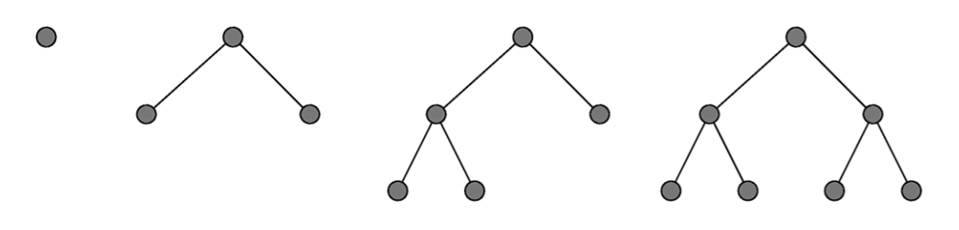
BFS
Strategy:
Expand Root Node
Expand successors of root node
Expand successors of successors of root node, etc.
Implementation:
Use FIFO queue to store fringe nodes in general tree search algorithm.
Always expands an unexpanded node at the greatest depth.

Slide 5
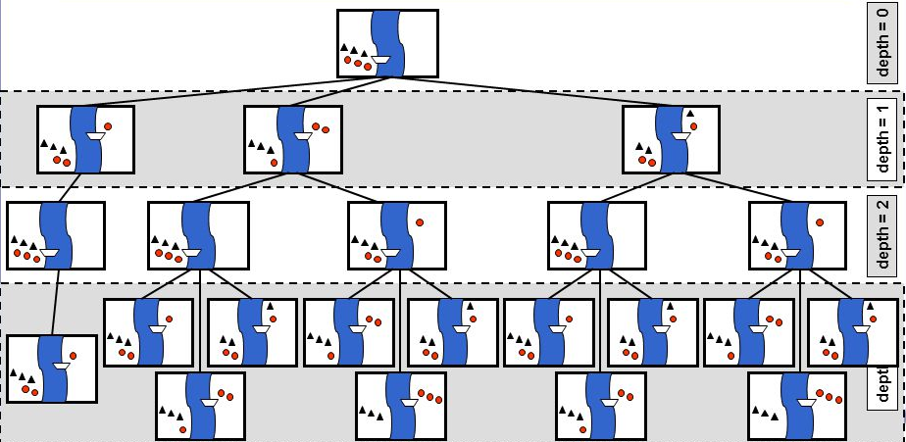
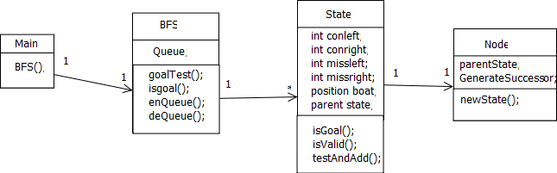
BFS State Diagram : Class Diagram

Slide 6
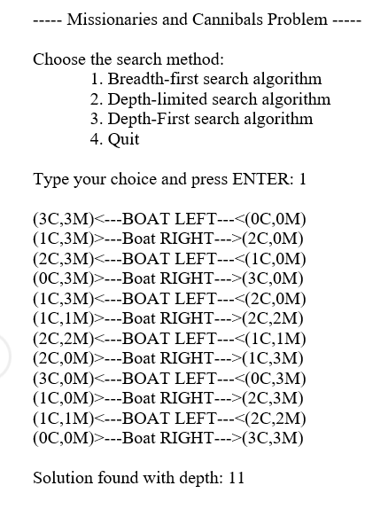
Output:

Slide 7
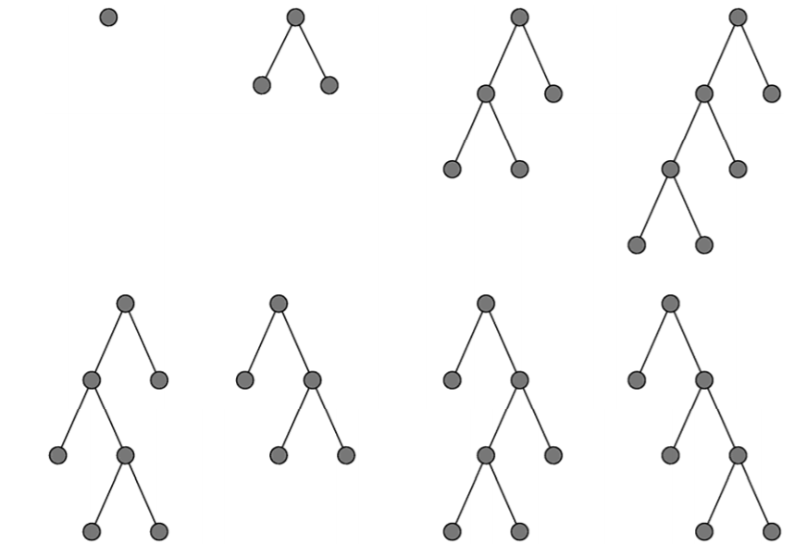
DFS
Strategy:
Always expand the deepest node in the current fringe first.
When a sub-tree has been completely explored, delete it from memory and “back up”
Implementation:
Use LIFO stack to store fringe nodes in general tree search algorithm.
Nodes are expanded in order they were produced.

Slide 8
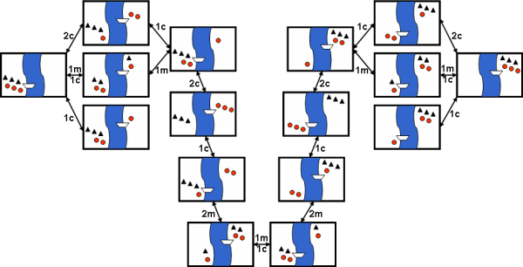
DFS – State

Slide 9
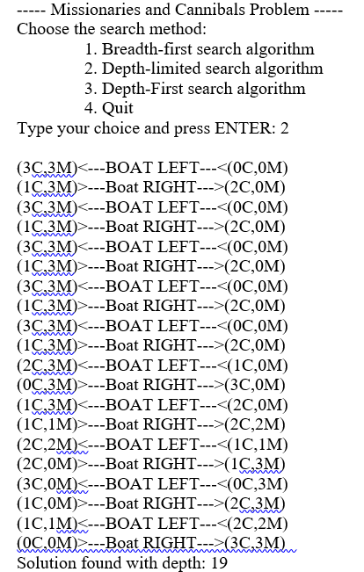
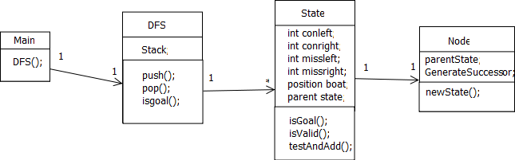
Class Diagram

Slide 10
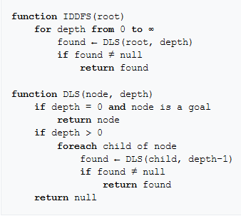
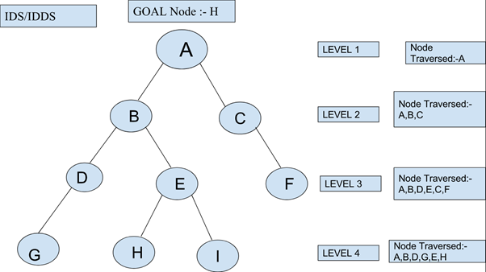
IDS Algorithm -

Slide 11
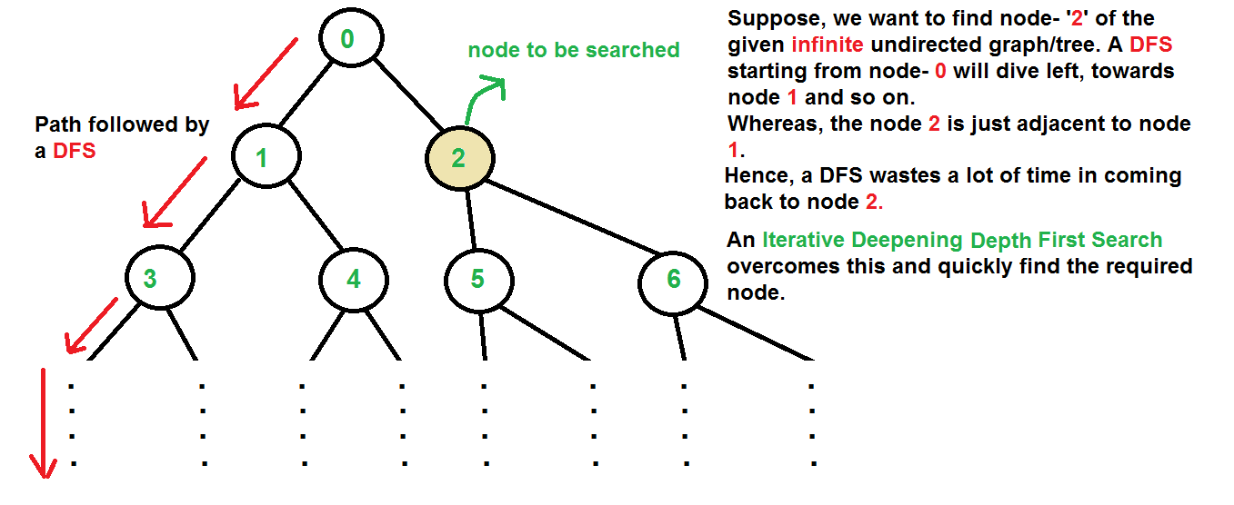
Why IDDFS..

Slide 12
Comparing all 3
BFS goes level by level, but requires more space.
The space required by DFS is O(d) where d is depth of tree, but space required by BFS is O(n) where n is number of nodes in tree.
IDDFS combines depth-first search’s space-efficiency and breadth-first search’s fast search (for nodes closer to root).
we find that asymptotically IDDFS takes the same time as that of DFS and BFS, but it is indeed slower than both of them as it has a higher constant factor in its time complexity expression.

Slide 13
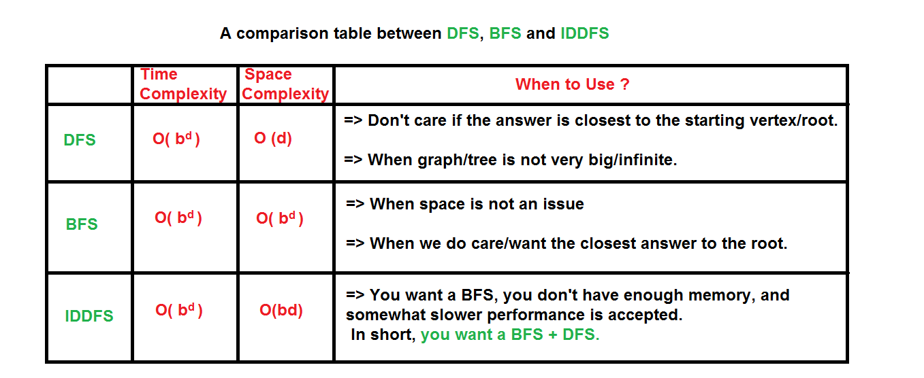
Comparing all 3

Slide 14
References
GeeksforGeeks : Iterative Deepening Search(IDS) or Iterative Deepening Depth First Search(IDDFS)
YouTube: Missionaries and Cannibals AI Game with solution
NOTE: To help understand all 3 better: http://nptel.ac.in/courses/106105078/pdf/Lesson%2004.pdf
http://flipkarma.com/media_dir/main_documents/Misionaries_And_Cannibals_Report.pdf

Slide 15
Thank You.

Slide 16

The Game Video!!YaaY!! (Link, just in case: https://www.youtube.com/watch?v=tZK3t-aUkKQ )

